Slide 1
Inclusive Mobility
Valérie Van Hees
Dominique Montagnese

Slide 2
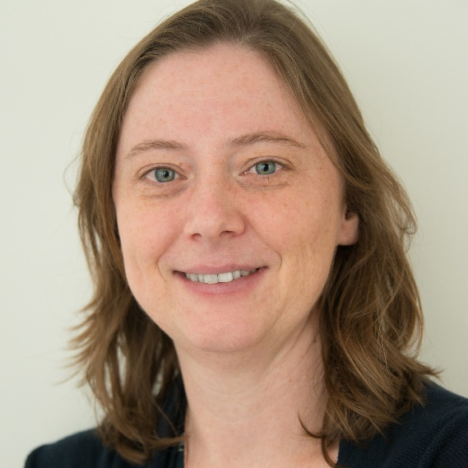
Introduction
Dominique Montagnese
Inclusive Mobility Expert SIHO
@DominMontagnese
Valérie Van Hees
Coordinator SIHO
@valerievanhees
@SIHOtweets
Inclusive Mobility
www.siho.be

Slide 3
Content
About SIHO
Inclusive mobility: context in Flanders and Europe
Inclusive mobility projects: EPFIME and PLAR-4-SIMP
SIHO’s support towards UAS case study Artevelde UAS
Next steps: stay connected!
Inclusive Mobility
www.siho.be

Slide 4
About SIHO

Slide 5
Inclusive Mobility
www.siho.be

Slide 6
Establishment by law and financing Support Centre Inclusive Higher Education (SIHO)
Cooperation between Ministry of Education and Training and the five university associations
Support towards different stakeholders:
Ministry of Education and Training
Higher Education Institutions
Students and student unions
Relevant stakeholders - society at large
Systematic approach
Inclusive Mobility
www.siho.be

Slide 7
Inclusive mobility Context Flanders and in Europe

Slide 8
Flemish context
Action plan for mobility of students (2013)
Specific attention for inclusion:
- targets
- comprehensive monitoring
33% of the mobile students should
belong to underrepresented groups
- students with study grant
- students with disabilities
- working students
Inclusive Mobility

Slide 9
Flemish context
 | % mobile degrees of underrepresented groups / all degrees of underrepresented groups | % mobile degrees of underrepresented groups/all mobile degrees | % students from underrepresented groups that obtain a degree (mobile and non-mobile) / all degrees
Belongs to underrepresented groups | 16.40% | 22.20% | 24.60%
Received a study grant | 17.20% | 20.90% | 22.00%
Was working student | 7.05% | 1.04% | 2.53%
Had a disability | 17.51% | 0.96% | 0.99%
Flemish average | 17.24%
Percentages of mobile initial degrees from students of underrepresented groups 2018-2019 - Monitor student mobility Action plan “Brains on the Move” Flemish Government
Inclusive Mobility
www.siho.be

Slide 10
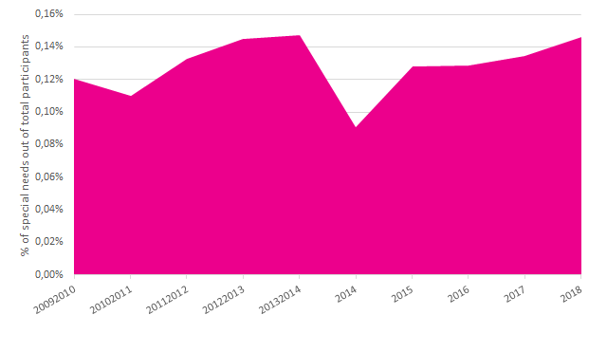
European context
Students who received a special needs support represent
only 0.11-0.18% of the beneficiaries in Erasmus+ mobilities for Higher Education studies and traineeships over the past 10 years.
Inclusive Mobility
www.siho.be

Slide 11
Inclusive Mobility
www.siho.be

Slide 12
Inclusive Mobility projects
Inclusive Mobility
www.siho.be

Slide 13
Enhancing a thought-out Policy and Framework on Inclusive Mobility across Europe (EPFIME)
Examine in-depth the needs and expectations on inclusive mobility of national authorities, students with disabilities and higher education institutions across Europe, while focusing on how national authorities and higher education institutions can collaborate more strongly to increase the quality and the transportability of support services for both incoming and outgoing students with disabilities in exchange programmes
Period: May 2019 - May 2021
.
Inclusive Mobility
www.siho.be

Slide 14
Peer Learning Activities and Resources for Social Inclusion in Mobility Programmes (PLAR-4-SIMP)
Support national authorities and higher education institutions across EHEA in the reform of their policies and practices to widen the participation of disadvantaged and underrepresented students in mobility programmes through 1) peer learning 2) resources
Period: May 2020 - May 2022
Inclusive Mobility
www.siho.be

Slide 15
1134 students with disabilities from 30+ countries
All types of disabilities represented.
Student survey
23 Ministries from 22 countries
Albania, Andorra, Austria, Belgium - French Community, Belgium - Flanders, Cyprus, Czech Republic, Denmark, Estonia, Germany, Greece, Hungary, Ireland, Italy, Kazakhstan, Liechtenstein, Luxembourg, Romania, Slovak Republic, Slovenia, Switzerland, Ukraine, United Kingdom - Scotland
Ministry survey
Higher Education Institutions survey
114 Universities from 22 countries
Inclusive Mobility
www.siho.be

Slide 16
Inclusion in mobility strategies
Information provision and mobility promotion
Grants, funding and application
Support services
Student life
Awareness and cooperation
Inclusive Mobility
www.siho.be

Slide 17
Inclusion in Mobility strategies
“ There is a lack of quantitative and/or qualitative targets in the national policies on participation of students with disabilities and proper data management tools. ”
Inclusive Mobility
www.siho.be

Slide 18
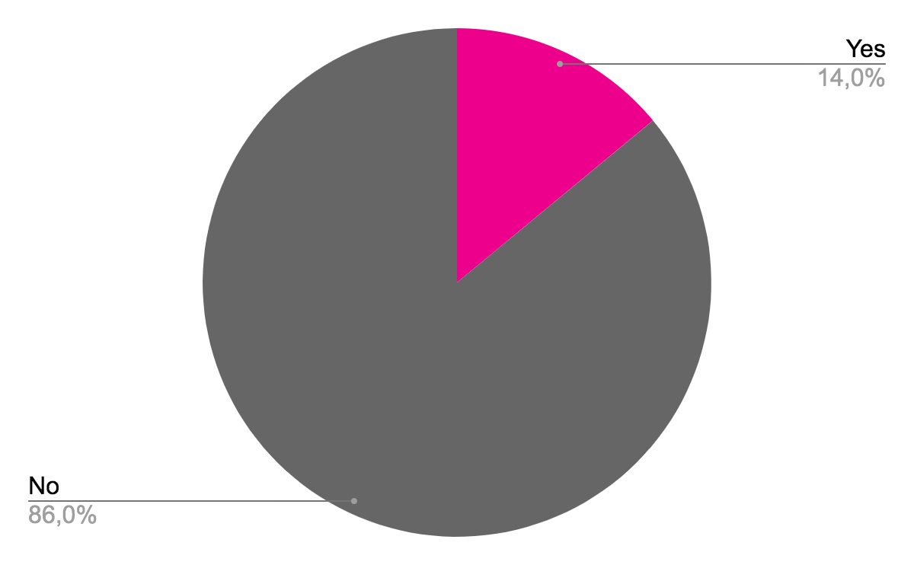
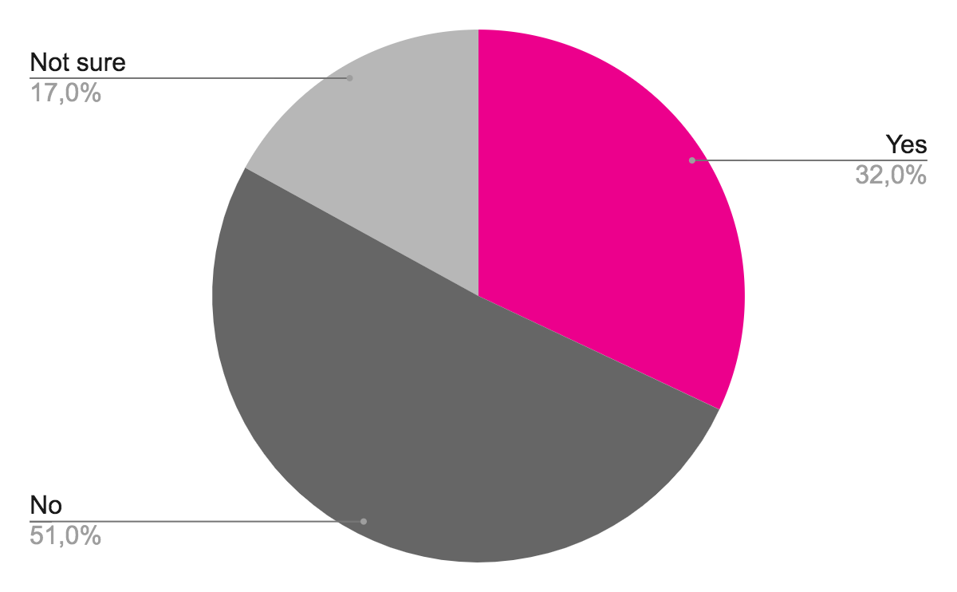
Inclusion in Mobility strategies
At Ministry level
At Institutional level
Have mobility targets for students with disabilities
Have inclusive mobility in their institutional strategic plan
Inclusive Mobility
www.siho.be
Inclusive Mobility
www.siho.be

Slide 19
Inclusion in Mobility strategies
 | Definitions of disability are varied and diverse across EHEA countries
 | Data collection is not common and often limited to collecting mobility data Erasmus+ programma (outward mobility
 | Inclusion measures, targets to ensure social inclusion in mobility towards students with disabilities are not common at country and institutional level.
 | The impact of mobility abroad is rarely studied at national authority level.
Inclusive Mobility
www.siho.be

Slide 20
Inclusion in Mobility strategies
 | Belgium - Vives University of Applied Sciences/Flemish Community - The internationalisation strategic plan ensures necessary structures so that all students and staff can gain an international experience by removing all possible barriers (including financial, physical and mental barriers) and by offering qualitative support for both incoming and outgoing students with specific needs (e.g. short mobility options, targeted mobility grants, qualitative support before, during and after a mobility period).
Inclusive Mobility
www.siho.be

Slide 21
Information provision and mobility promotion
“ I have not heard of any information about an Erasmus programme for disabled students. ”
“ Much of the information on the foreign exchange programmes is given via public talks without captioning, interpreters or video recordings, and questions are generally taken verbally or over the phone, which is inaccessible to me as a deaf person. ”
Inclusive Mobility
www.siho.be

Slide 22
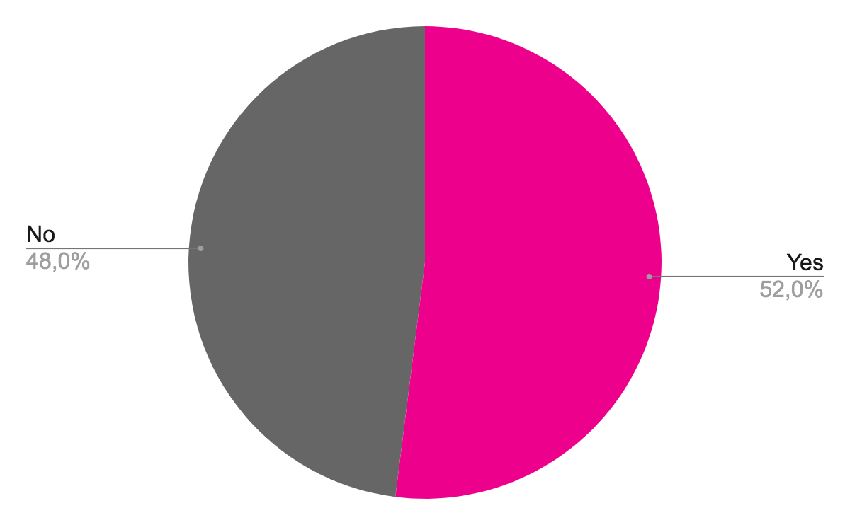
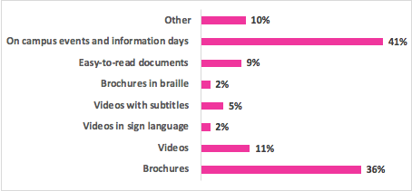
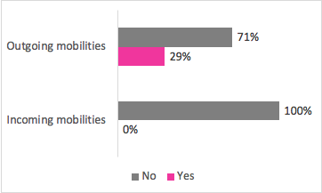
Information provision and mobility promotion
At Ministry level
At Institutional level
Is specific information on mobility provided for students with disabilities?
Ways to provide information on mobility abroad
towards students with disabilities
Initiatives to attract more incoming students with disabilities and encourage more outgoing students with disabilities
Inclusive Mobility
www.siho.be
Inclusive Mobility
www.siho.be

Slide 23
Information provision and mobility promotion
 | Some higher education institutions already encourage students with disabilities to go abroad, but only a limited number of higher education and no national authorities seem to be actively encouraging students with disabilities to come to their institutions.
 | The information provision and promotion on mobility abroad for students with disabilities is lacking. Campaigns are limited and do not reach students with disabilities.
Inclusive Mobility
www.siho.be

Slide 24
Information provision and mobility promotion
 | Greece - The Erasmus+ National Agency - instructs higher education institutions to give priority to students with special needs as long as they fulfil the selection criteria, and it has published leaflets in braille for distribution to Greek higher education institutions.
Inclusive Mobility
www.siho.be

Slide 25
Funding, grants and application
“ The greatest barrier is the limitation of funds, which makes it difficult to cater for all the needs of students with disabilities. Outgoing students, who are not taking part in Erasmus+ or national programmes, do not get funding for the additional costs due to their disability …. Some forms of financial support (e.g. sign interpreters, pedagogical help, etc.) can in principle also be deployed abroad, but some regulations are very complicated and require a lot of administration. ”
Inclusive Mobility
www.siho.be

Slide 26
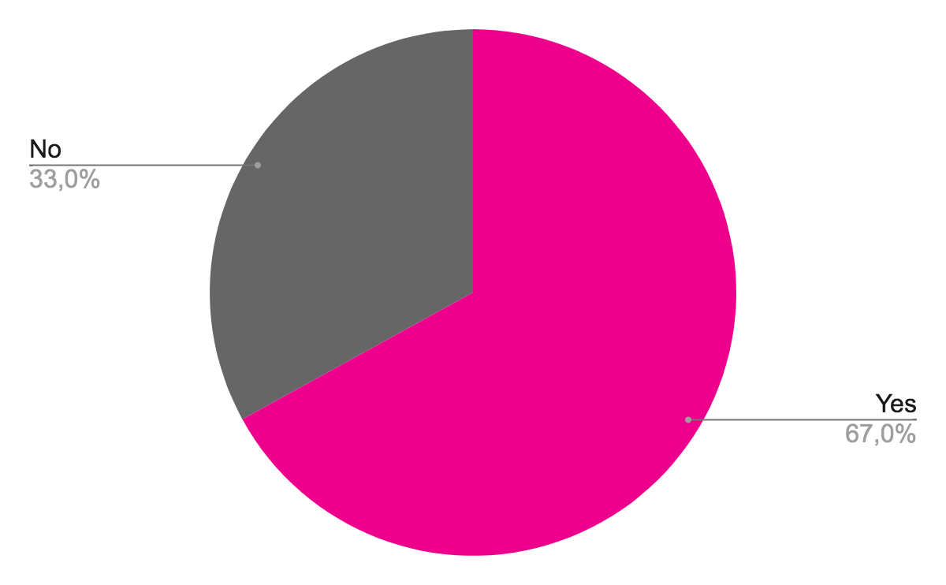
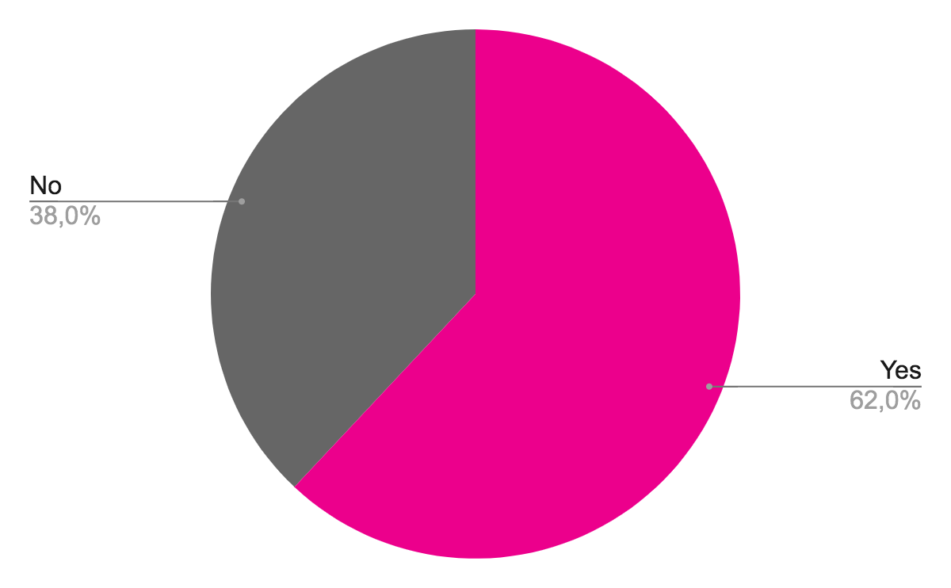
Funding, grants and application
Percentage provision of specific mobility grants or support services for outgoing SWD
Percentage portability of national grants or support services abroad
14 ministries out of 20 provide additional specific mobility grants and/or support services for students with disabilities going on a mobility abroad.
In 13 countries out of 21, national grants and support services for students with disabilities are said to be transportable abroad for an exchange programme, while this is not the case in 8 countries.
Inclusive Mobility
www.siho.be

Slide 27
Funding, grants and application
 | Students with disabilities, higher education institutions and national authorities report significant barriers in the application process and the portability of grants and support services abroad.
 | When an additional Erasmus+ grant was approved, the overall satisfaction regarding the covering of financial expenses are positive for students with disabilities.
 | The lack of transportability of grants and support systems hinders students with disabilities to undertake a mobility abroad.
 | Pre visits are valued as extremely helpful for students with disabilities and the home institution.
Inclusive Mobility
www.siho.be

Slide 28
Funding, grants and application
 | Belgium - EPOS, the Flemish Erasmus+ National Agency - developed an easy funding application process for preparatory visits to the student mobility destination in Erasmus+ mobilities. A trusted person/coach can also accompany the student on this preparatory visit.
Inclusive Mobility
www.siho.be

Slide 29
Support services
“ It takes a lot of time to organise the support abroad. The Erasmus+ funding is often not confirmed until very late. No guarantee that additional costs can all be covered by this funding. Students are fearful of not getting support abroad, students need a support network which would not be available abroad. It is particularly difficult for students with physical and sensory disabilities who are often reliant on family members for support needs. They may have to organise their own supports outside of college hours (e.g. Personal Assistant, transport, etc.) ”
Inclusive Mobility
www.siho.be

Slide 30
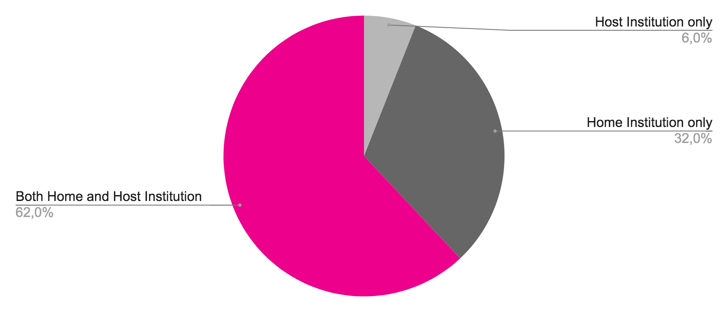
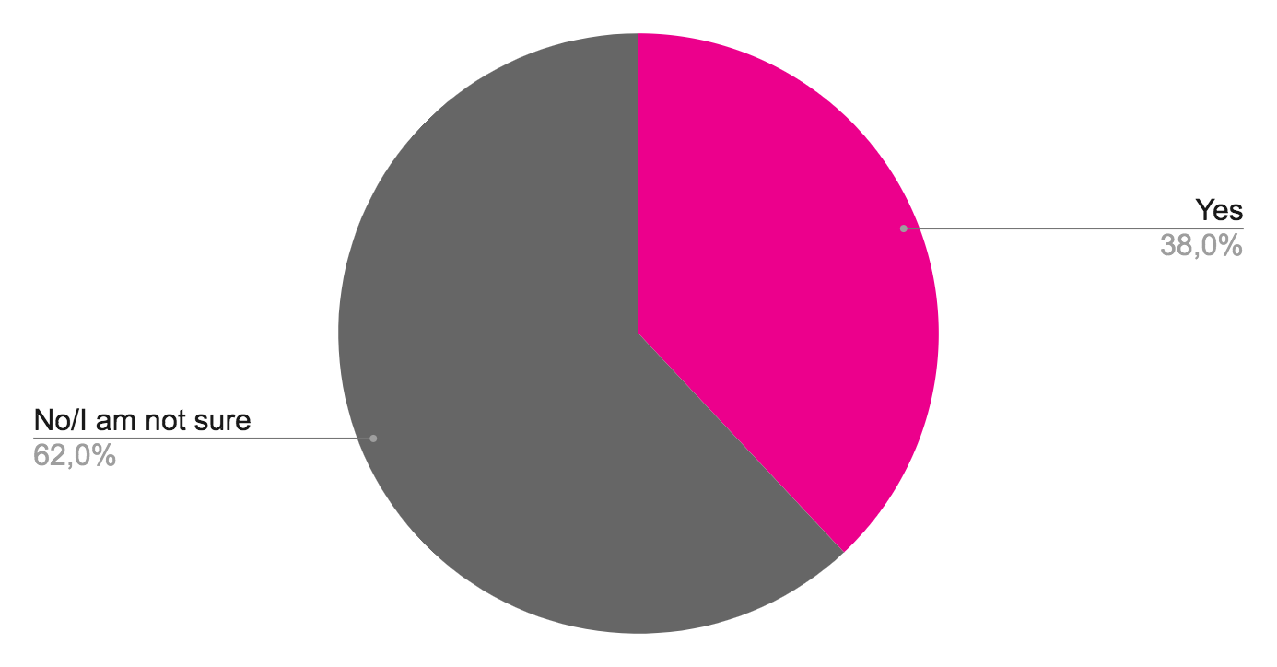
Support services
Have specific administration procedures in place for the mobility of students with disabilities
(institution survey)
Disclosure of disability
(student survey)
Inclusive Mobility
www.siho.be

Slide 31
Support services
 | Disclosure of the disability is an important topic for students with disabilities. When preparing their mobility abroad, many students disclose their situation both to the home and the host institution.
 | Institutions of higher education do not automatically acknowledge the disability status as well as the reasonable adjustment offered by the home institution.
 | Students with disabilities are rather positive about the support services offered by the host institution. Students value foremost the support from staff during the international mobility period and consultation about their needs and preferences.
Inclusive Mobility
www.siho.be

Slide 32
Support services
 | France - Université de Lorraine - In the Erasmus+ inter-institutional agreements, the mentions explicitly the engagement and capacity to welcome incoming students and staff with disabilities. Regarding outgoing mobility, at least 4 months before the mobility takes place, a meeting is held between the student, the international officer, the disability officer and the academic department concerned to identify all the individual needs of the student in the host institution.
Inclusive Mobility
www.siho.be

Slide 33
Student life
“ My student dorm is managed by the office of equal opportunities, therefore it is specialized for students with disabilities. Therefore the management also knows how to help us. And the people are also kind and helpful in this dorm. ”
Inclusive Mobility
www.siho.be

Slide 34
Student life
 | The satisfaction regarding the offered student housing is rather positive
 | Students point out the lack of available information regarding the accessibility of the destination, transport, housing and campus, and the best places to go socially.
 | Students point to more support with everyday life necessities (e.g. medical support, cooking, etc...).
Inclusive Mobility
www.siho.be

Slide 35
Student life
 | Italy - The Università di Trento - cooperates with the Erasmus Student Network (ESN) to welcome and integrate their incoming students, especially those with disabilities. This cooperation focuses mostly on organising campus tours with the international students and searching for buddies to support students with disabilities to overcome everyday challenges.
Inclusive Mobility
www.siho.be

Slide 36
Awareness and cooperation
“ Specific barriers could be also the lack of translators to a particular sign language or the lack of coordinators for student support (disability/inclusion officers). Improvement of cooperation between support coordinators and international officers is crucial but challenging. ”
Inclusive Mobility
www.siho.be

Slide 37
Awareness and cooperation
 | The lack of awareness on the barriers and communication and collaboration between different stakeholders are a barrier supporting international students with disabilities effectively.
Inclusive Mobility
www.siho.be

Slide 38
Awareness and cooperation
 | Ireland - Higher Education Authority - As part of their audit and monitoring visits to Irish HEI’s participating in Erasmus+, the HEA’S international section actively engages with disability officers based at each institution to communicate the opportunities available to students with disabilities to partake in Erasmus+, and about the additional supports available for them.
Inclusive Mobility
www.siho.be
www.siho.be

Slide 39
SIHO’s support Artevelde as a case study
Inclusive Mobility
www.siho.be

Slide 40
Inclusive Mobility
www.siho.be

Slide 41
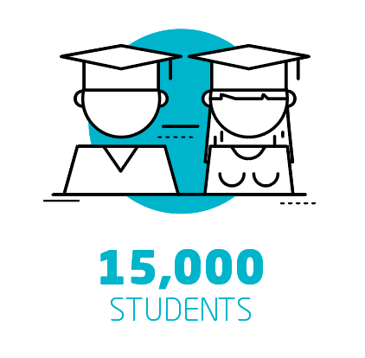
Some Quick Facts
Inclusive Mobility
www.siho.be

Slide 42
Internationalisation for Students at Artevelde University of Applied Sciences
Inclusive Mobility
www.siho.be

Slide 43
Internationalisation for Students at Artevelde University of Applied Sciences
Going Abroad
All our students can:
Spend at least one semester at one of our partner institutions abroad in the context of their studies;
Apply for an international internship;
Enrol in joint degree programmes, excellence programmes and summer school courses.
Internationalisation @ Home
Students who prefer not to travel abroad, will get a taste of different cultures thanks to one of the following initiatives:
Classes in English, together with international students;
Increasing virtual initiatives;
Guest lecturers, especially during an international week / international days organised by each department;
Our lecturers integrate foreign-language texts or teaching materials into their programme;
All local students can apply to become the buddy of an incoming international student.
Inclusive Mobility
www.siho.be

Slide 44
Setting up a strategy on inclusive mobility
Cocreation approach
Internationalisation office (coordinator initiative)
Coordinators internationalization 5 expertise domains
Student services
Students
SIHO (self-assessment, coaching/advise)
… and participating in SIHO’s inclusive mobility learning network
… organizing international staff mobility with SIHO
Inclusive Mobility
www.siho.be

Slide 45
Next steps Stay connected!
Inclusive Mobility
www.siho.be

Slide 46
Research report and booklet Webinar 9 November 2020 (EPFIME) Frameworks, self-assessment, guideline, inclusivemobility.eu
March/April 2021 (EPFIME)
Inclusive Mobility
www.siho.be

Slide 47
Peer Learning 2020-2022 (PLAR-4-SIMP) Database, policy report, communication and training package
March/April 2022 (PLAR-4-SIMP)
Inclusive Mobility
www.siho.be

Slide 48
Flemish learning network 2020-2024 (SIHO) International staff training 2021-2022 (SIHO – Artevelde UAS)
Inclusive Mobility
www.siho.be

Slide 49
Stay tuned about SIHO
www.siho.be - @SIHO_tweets
Inclusive Mobility
www.siho.be

Slide 50
Stay tuned about IM.eu
www.inclusivemobility.eu
Inclusive Mobility
www.siho.be

Slide 51
Q&A questions
Inclusive Mobility
www.siho.be

Slide 52
Inclusive Mobility
Valérie Van Hees
Dominique Montagnese

